Slide 1

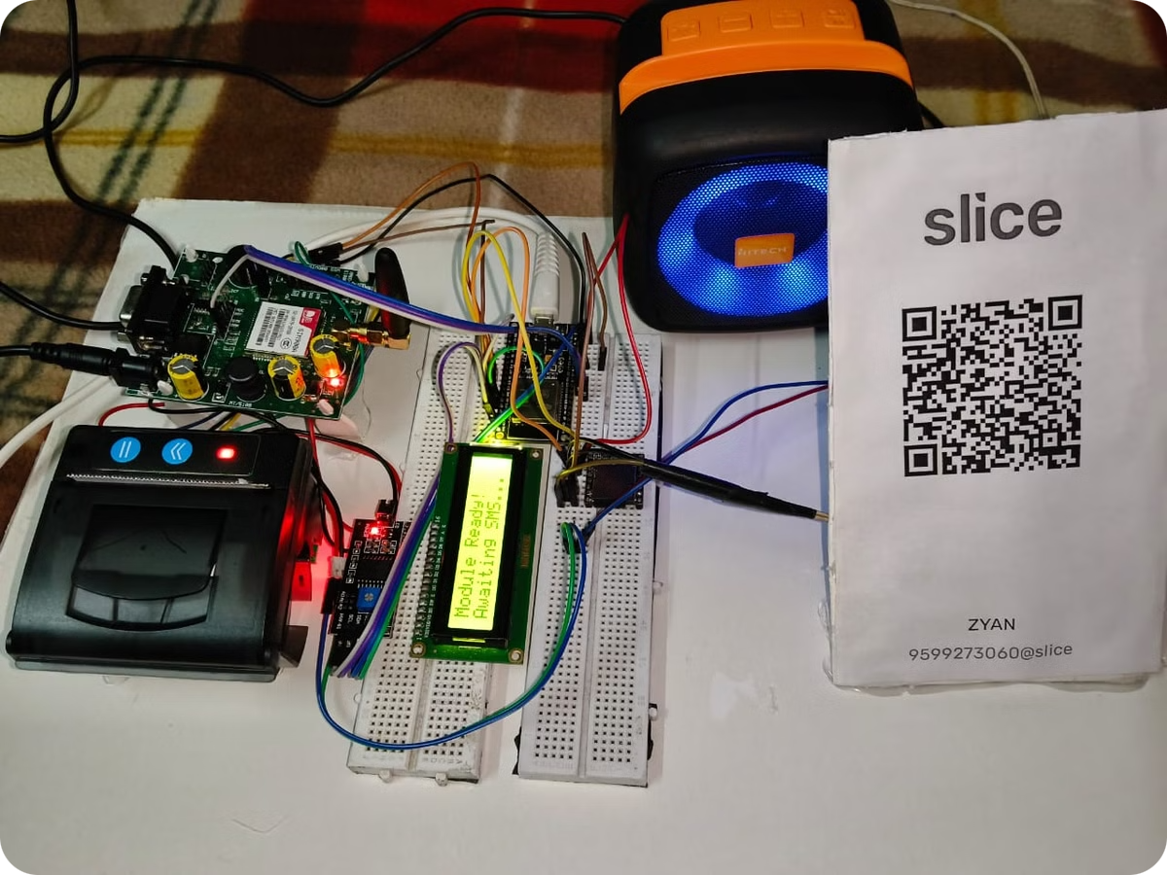
Smart Payment System
Introducing the Paytm Business Account Payment Feedback System, a comprehensive solution that streamlines payment processing and provides real-time audio and visual feedback to business owners.

Slide 2


Seamless GSM Connectivity
1
GSM Connectivity
2
SMS Reading
3
Amount Extraction
The system utilizes a SIM900A-GSM module to establish a reliable GSM connection, enabling seamless communication with the Paytm platform.
The system automatically reads and processes payment confirmation SMS messages received from Paytm, extracting the relevant transaction details.
The system intelligently parses the SMS content to accurately identify and extract the payment amount, ensuring precise tracking of business revenue.

Slide 3

Hardware Components
ESP32 Board
SIM900A-GSM Module
Peripheral Devices
The system is powered by the versatile ESP32 board, providing the necessary processing capabilities and connectivity options.
The SIM900A-GSM module enables seamless GSM communication, allowing the system to receive and process Paytm SMS messages.
The system integrates a Liquid-crystal display, EP24 Thermal Printer, and DF Player Mini speaker to provide comprehensive feedback to the business owner.

Slide 4

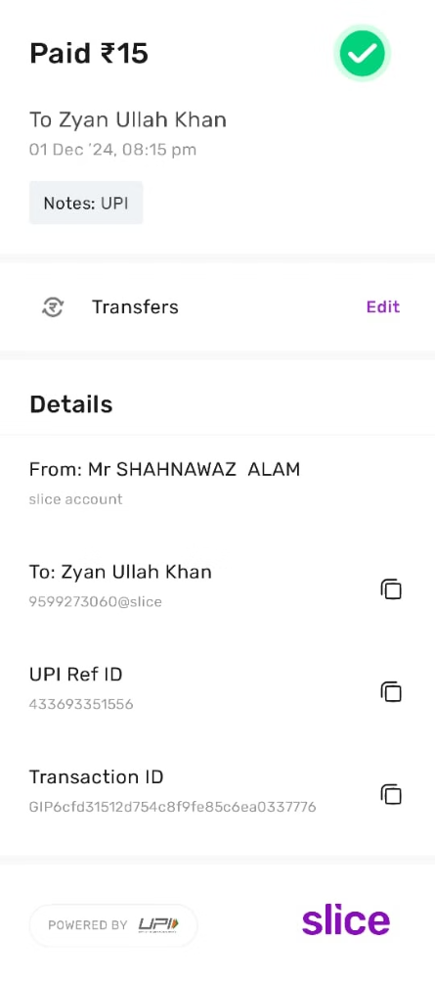
Intelligent SMS Processing
1
SMS Reception
The system continuously monitors for incoming Paytm SMS messages, ensuring prompt detection of new payment notifications.
2
Amount Extraction
The system utilizes advanced parsing algorithms to accurately extract the payment amount from the SMS content.
3
Transaction Recording
The extracted payment details are securely stored and documented for the business owner's reference and financial tracking.

Slide 5

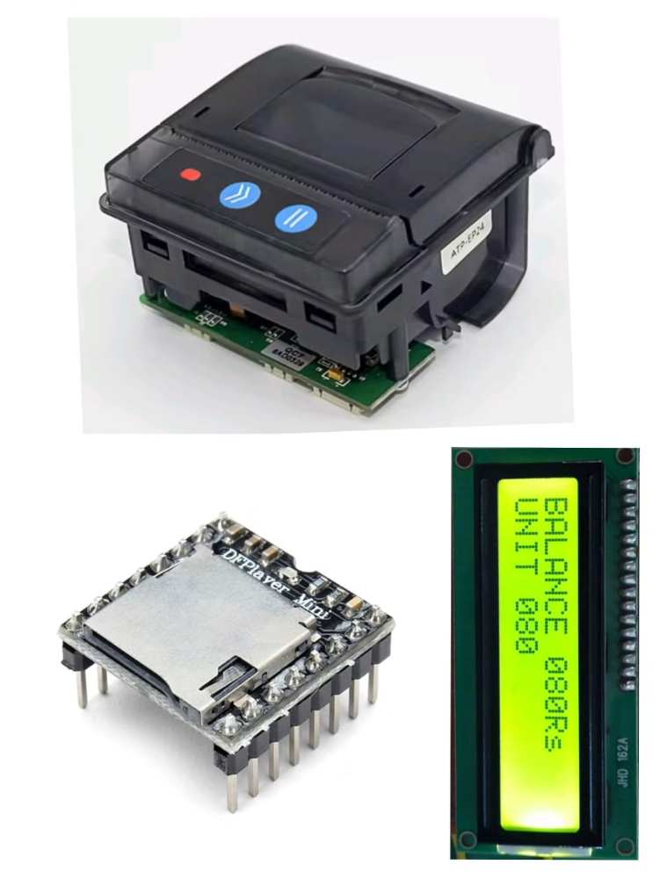
Comprehensive Feedback
Display
Printing
The Liquid-crystal display presents the payment details in a clear and easily readable format, keeping the business owner informed in real-time.
The EP24 Thermal Printer automatically generates a physical receipt for each payment, providing a tangible record of the transaction.
Audio
The DF Player Mini speaker delivers an audible confirmation of the payment, alerting the business owner and creating a positive customer experience.

Slide 6




Secure your Payment
The system seamlessly integrates with the Paytm mobile app, providing a unified platform for managing business transactions.
Digital Banking
The system's connectivity with the Paytm platform ensures secure and efficient digital banking, streamlining the payment reconciliation process.
Data Integration
The system's ability to automatically extract and record payment details provides valuable business insights and simplifies financial reporting.

Slide 7




Enhance the Customer Experience
Instant Feedback
The immediate audio and visual confirmation of a successful payment enhances the customer experience, fostering trust and satisfaction.
Printed Receipt
The automated generation of a physical receipt provides customers with a tangible record of their transaction, adding a professional touch.
Streamlined Process
The seamless integration and efficient processing of payments create a smooth and enjoyable experience for both the business owner and the customer.

Slide 8

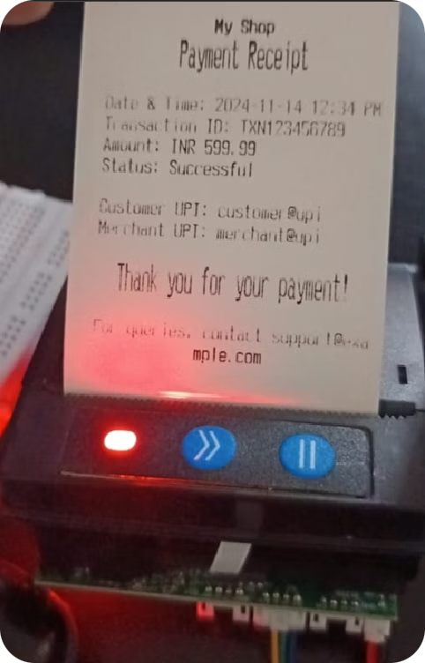
Conclusion
1
Improved Revenue Tracking
2
Enhanced Customer Satisfaction
The system's ability to accurately record and monitor payment details provides valuable insights for business growth and decision-making.
The positive customer experience and efficient payment processing can lead to increased customer loyalty and repeat business.
3
Future Enhancements
The modular design of the system allows for seamless integration of additional features and functionalities to meet evolving business needs.

Slide 9
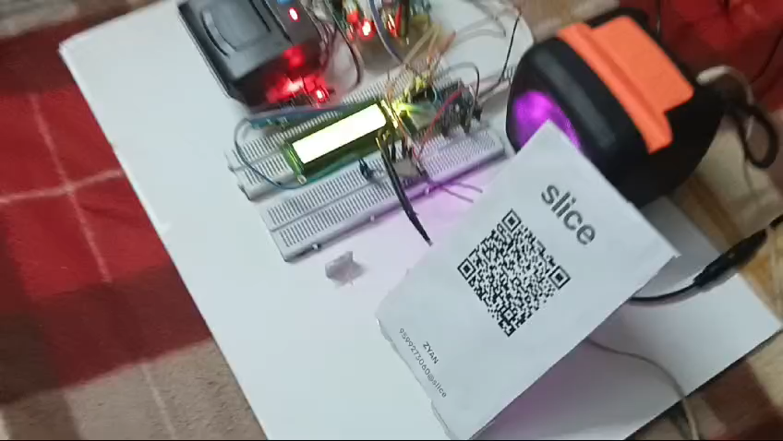

Thank You!

